Slide 1
Decision Tree Method-WORKSHOP PYTHON

Slide 2
Introduction to Decision Tree:Recap
One of the most robust predictive modeling techniques, Decision Tree uses data mining techniques for model building.
Decision Tree breaks down a data set into smaller subsets and presents association between target variable(dependent) and independent variables as a tree structure.
Final result is a tree with Decision Nodes and Leaf Nodes.
A decision node has two or more branches and leaf node represents a classification or decision.

Slide 3
Decision Tree – Basic Components
Component | Description | Alternate terms
Root node | Has no incoming edges and zero or more outgoing edges | Parent node
Internal nodes | Each has exactly one incoming edge and two or more outgoing edges | Decision nodes / Child nodes
Leaf node | Each has exactly one incoming edges and no outgoing edges | Terminal nodes
Branches | Categories of attributes | Edges

Slide 4
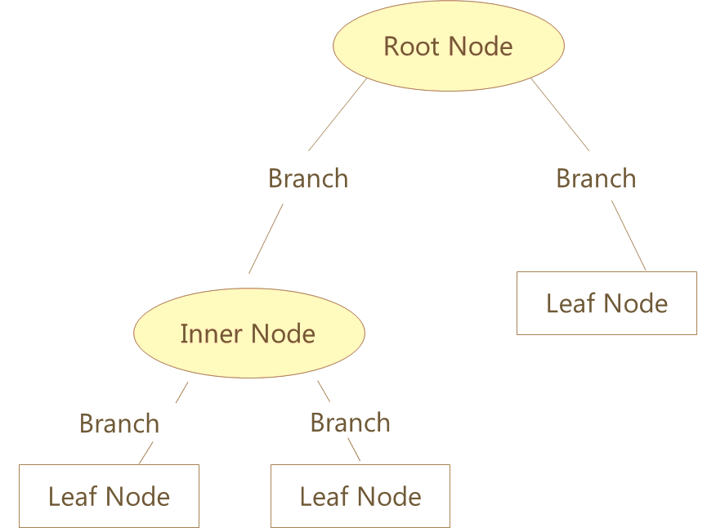
Decision Tree – Basic Components
The first variable used for separating the observations
Categories of Attribute
Next attribute for separating the observations
Class Labels
*
Class labels show observations belong to which class. The leaf node also shows Number of observations and Error rate (Actual classification vs classification given by the tree)

Slide 5

Entropy
Entropy measures the homogeneity of a sample. It is used as a parameter for checking the amount of uncertainty associated with a set of probabilities.
Entropy lies between 0 and 1
If the sample is completely homogeneous the entropy is 0 and if the sample is equally divided it has entropy of 1
Entropy can be of two types, for each category and at the variable level
Entropy of a category is calculated as:
where,
P1 is the proportion of class 1
P2 is the proportion of class 2
$$– P1∗log2(P1) – P2∗log2(P2)$$

Slide 6

Entropy of a Category
Let us consider survey data from three cities depicting shopper’s preferred brand
Entropy for each city is calculated as:
Delhi: $– 0.225∗ log2 (0.225)– 0.775∗ log2 (0.775) = 0.76919$
Chennai: $– 0.1∗ log2 (0.1) – 0.9∗ log2 (0.9) = 0.46900$
Mumbai: $– 0.5∗ log2 (0.5) – 0.5∗ log2 (0.5) = 1$
City | Brand A Voters | Brand B Voters | Number of Voters | % of votes for Brand A | % of votes for Brand B
Delhi | 90 | 310 | 400 | 22.5% | 77.5%
Chennai | 10 | 90 | 100 | 10% | 90%
Mumbai | 100 | 100 | 200 | 50% | 50%

Slide 7
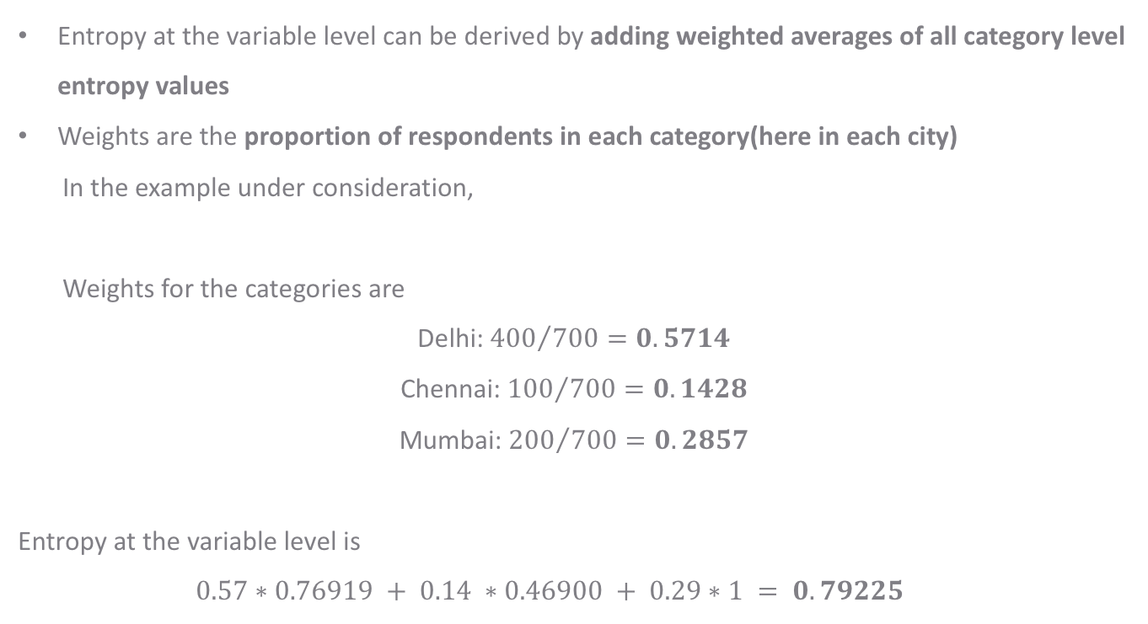
Entropy at the Variable Level
Entropy at the variable level can be derived by adding weighted averages of all category level entropy values
Weights are the proportion of respondents in each category(here in each city)
In the example under consideration,
Weights for the categories are
Delhi: ${400}/{700}=0.5714$
Chennai: ${100}/{700}=0.1428$
Mumbai: ${200}/{700}=0.2857$
Entropy at the variable level is
$$0.57∗0.76919 + 0.14 ∗0.46900 + 0.29∗1 = 0.79225$$

Slide 8
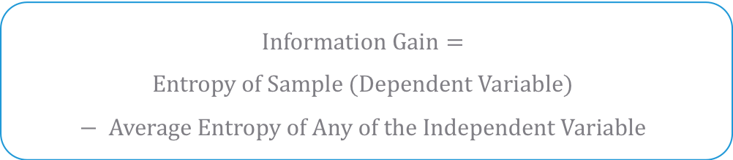
Information Gain
Information Gain is based on the decrease in entropy after a dataset is split on an attribute
Constructing a decision tree is about finding attribute that returns the highest information gain
Information gain can be interpreted as ability of reducing the uncertainty (Entropy) and hence increase predictability
$$Information Gain=$$
$$Entropy of Sample (Dependent Variable)− Average Entropy of Any of the Independent Variable$$

Slide 9
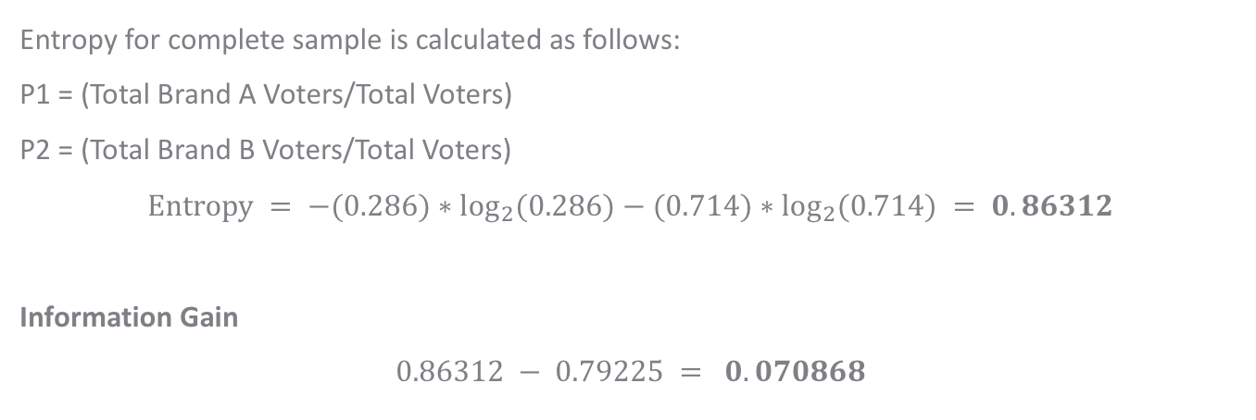
Information Gain
City | Brand A Voters | Brand B Voters | Number of Voters | % of votes for Brand A | % of votes for Brand B
Delhi | 90 | 310 | 400 | 22.5% | 77.5%
Chennai | 10 | 90 | 100 | 10% | 90%
Mumbai | 100 | 100 | 200 | 50% | 50%
Entropy for complete sample is calculated as follows:
P1 = (Total Brand A Voters/Total Voters)
P2 = (Total Brand B Voters/Total Voters)
$$Entropy = −(0.286)∗\log_{2}⁡(0.286)−(0.714)∗\log_{2}⁡(0.714) = 0.86312$$
Information Gain
$$0.86312 − 0.79225 = 0.070868$$
Entropy at the variable level (Weighted average)

Slide 10
Information Gain…
Information Gain value is used to determine which attribute is the “best” – the attribute with most information gain is chosen
Information gain for a variable is high when that variable has the low entropy at the variable level (Weighted average)
Low entropy for a variable implies the classification based on that attribute is fairly homogenous , hence this attribute is selected as the first best attribute
The same process is repeated till all attributes are used as split variables

Slide 11
Case Study – Predicting Loan Defaulters
Background
Objective
Available Information
The bank possesses demographic and transactional data of its loan customers. If the bank has a robust model to predict defaulters it can undertake better resource allocation.
To predict whether the customer applying for the loan will be a defaulter
Defaulter (=1 if defaulter, 0 otherwise) is the dependent variable
Age group, Years at current address, Years at current employer, Debt to Income Ratio, Credit Card Debts, Other Debts are the independent variables
Sample size is 700

Slide 12
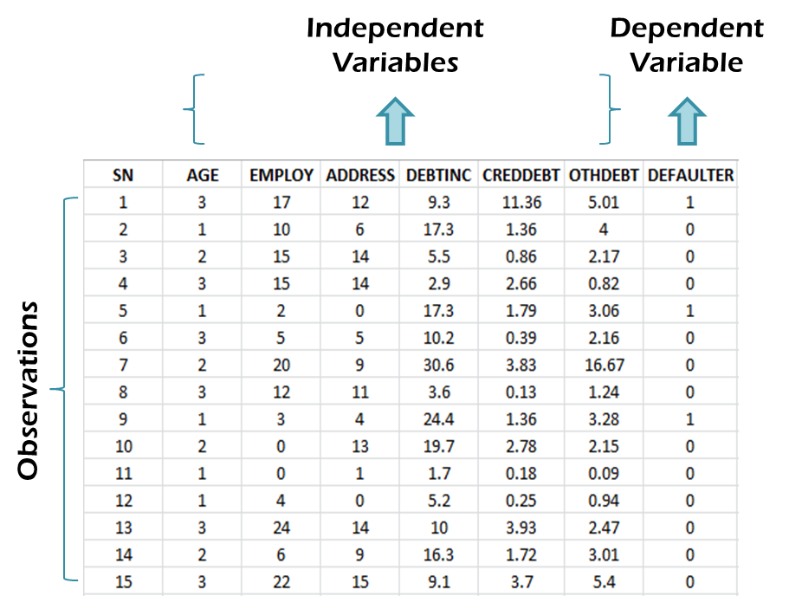
Data Snapshot
BANK LOAN
Column | Description | Type | Measurement | Possible Values
SN | Serial Number | Integer | - | -
AGE | Age Groups | Integer | 1(<28 years), 2(28-40 years), 3(>40 years) | 3
EMPLOY | Number of years customer working at current employer | Integer | - | Positive value
ADDRESS | Number of years customer staying at current address | Integer | - | Positive value
DEBTINC | Debt to Income Ratio | Continuous | - | Positive value
CREDDEBT | Credit to Debit Ratio | Continuous | - | Positive value
OTHDEBT | Other Debt | Continuous | - | Positive value
DEFAULTER | Whether customer defaulted on loan | Integer | 1(Defaulter), 0(Non-Defaulter) | 2

Slide 13
Classification Tree in Python
# Importing the Libraries
import pandas as pd import numpy as np import matplotlib.pyplot as plt from sklearn.model_selection import train_test_split from sklearn.tree import DecisionTreeClassifier, DecisionTreeRegressor, plot_tree from sklearn.metrics import confusion_matrix, precision_score, recall_score, accuracy_score,roc_curve, roc_auc_score
sklearn.tree module includes Decision Tree – based models for classification and regression

Slide 14
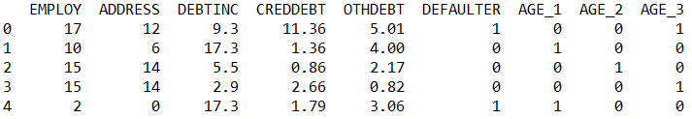
Classification Tree in Python
# Importing and Readying the Data for Modeling
bankloan = pd.read_csv("BANK LOAN.csv") bankloan1 = bankloan.drop(['SN'], axis = 1) bankloan1['AGE'] = bankloan1['AGE'].astype('category') bankloan2 = pd.get_dummies(bankloan1) bankloan2.head()
drop() is used to remove unwanted variables.
pd.get_dummies() converts categorical variables into dummy variables. Since AGE is a categorical variable, it is converted.
# Output

Slide 15
Classification Tree Using Information Gain
# Creating Data Partitions
X = bankloan2.loc[:,bankloan2.columns != 'DEFAULTER'] y = bankloan2.loc[:, 'DEFAULTER'] X_train, X_test, y_train, y_test = train_test_split(X, y, test_size = 0.30, random_state = 999)
train_test_split() from sklearn.model_selection is used to split dataset into random train and test sets.
test_size represents the proportion of dataset to be included in the test set.
random_state sets the seed for the random number generator.

Slide 16
Classification Tree Using Information Gain
# Classification Tree Using Information Gain
dtcl = DecisionTreeClassifier(criterion='entropy', min_samples_split= int(len(X_train)*.10)) dtcl.fit(X_train, y_train)
DecisionTreeClassifier() from sklearn.tree fits a classification tree.
criterion= ‘entropy’ specifies the function to measure the split. Default is ‘gini’ for Gini impurity. ‘entropy’ stands for information gain.
min_samples_split= minimum number of samples required to split an internal node. This number is set to be 10% of the sample size.
The output displays model specifications.

Slide 17
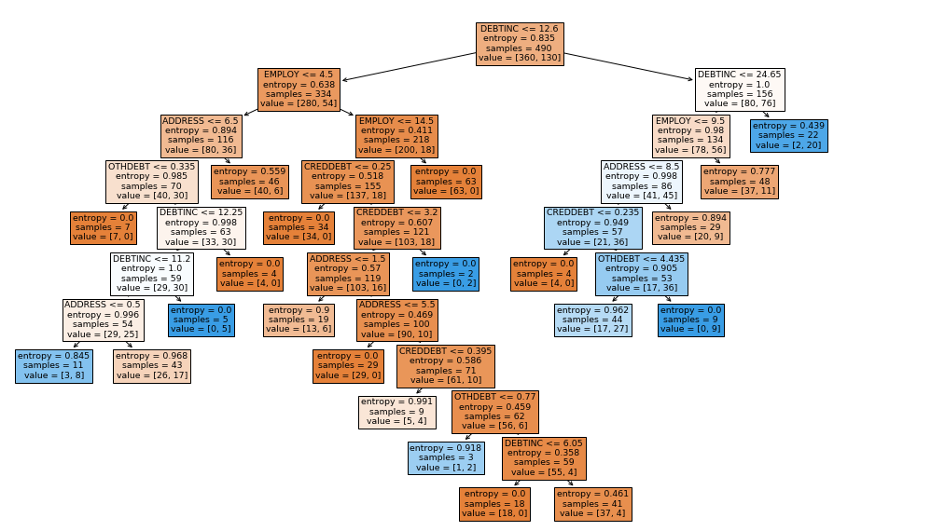
Classification Tree Using Information Gain
# Plotting The Tree
from sklearn.tree import plot_tree plt.figure(figsize = (16,10)) plot_tree(dtcl, filled = True, feature_names = list(X.columns)) plt.show();
plot_tree is used to plot the decision tree.
filled= True paints nodes to indicate majority class for classification and feature_names is used to mention the feature names.
# Output

Slide 18
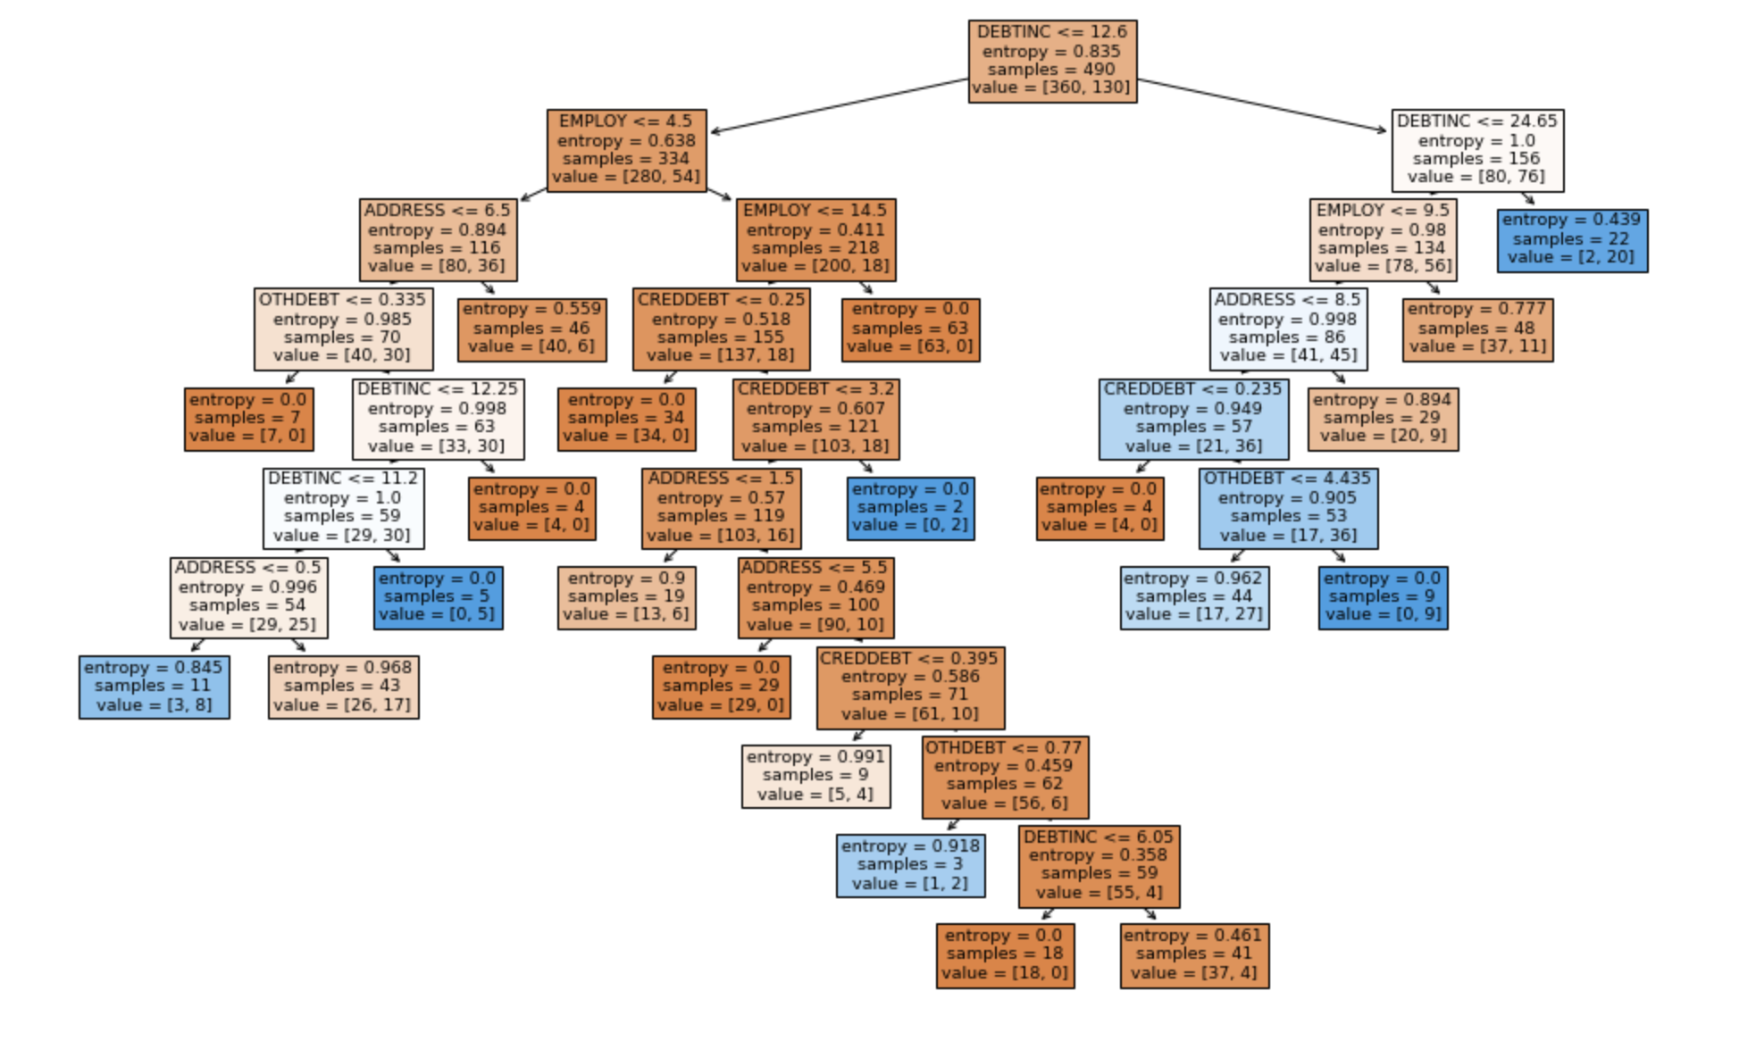
Classification Tree Interpretation
Node 1
Node 2
Node 3
Interpretation :
Due to a large number of continuous predictors, a tree with several nodes and branches is generated.
Tree starts with all 490 observations (Train set). 360 are non-defaulters (0) and the remaining 130 are defaulters (1).
DEBTINC is the first split variable, left branch is <=12.6 and right branch is >12.6. 334/490 have DEBTINC<=12.6.
EMPLOY is the second split on left branch, which further divides 334 obs. into 280 non-defaulters (0) and the remaining 54 as defaulters (1).
The algorithm progresses till no further variable split is left.

Slide 19
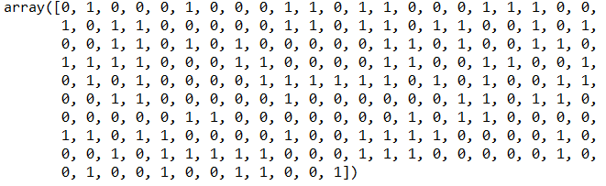
Classification Tree in Python – Prediction
# Generating Predictions for the model
y_pred = dtcl.predict(X_test) y_pred_probs = dtcl.predict_proba(X_test) cutoff = 0.3 pred_test = np.where(y_pred_probs[:,1] > cutoff, 1, 0) pred_test
# Output

Slide 20
Classification Tree in Python – ROC Curve
# Area Under ROC Curve
DTfpr, DTtpr, thresholds = roc_curve(y_test, y_pred_probs[:,1]) abline_probs = [0 for _ in range(len(y_test))] abline_auc = roc_auc_score(y_test, abline_probs) abline_fpr, abline_tpr, _ = roc_curve(y_test, abline_probs) plt.plot(abline_fpr, abline_tpr, linestyle='--', label='abline') plt.plot(DTfpr, DTtpr, marker='.', label='ROC Curve') plt.xlabel('False Positive Rate');plt.ylabel('True Positive Rate') plt.legend(); plt.show()

Slide 21
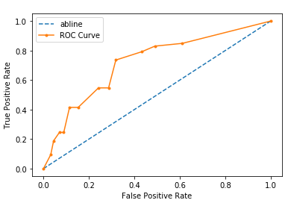
Classification Tree in Python – ROC Curve
# Output
# Plotting The Tree

Slide 22
Classification Tree in Python – Confusion Matrix
# Confusion Matrix
confusion_matrix(y_test, pred_test, labels=[0, 1]) array([[107, 50], [ 14, 39]], dtype=int64)
accuracy_score(y_test, pred_test) 0.6952380952380952
precision_score(y_test, pred_test) 0.43820224719101125
recall_score(y_test, pred_test) 0.7358490566037735
accuracy_score() = number of correct predictions out of total predictions
precision_score() = true positives / (true positives + false positives)
recall_score() also known as ‘Sensitivity’ = true positives / (true positives + false negatives)
# Area Under ROC Curve
auc = roc_auc_score(y_test, y_pred_probs[:,1]) print('AUC: %.3f' % auc) AUC: 0.720

Slide 23
THANK YOU!!

